Slide 1
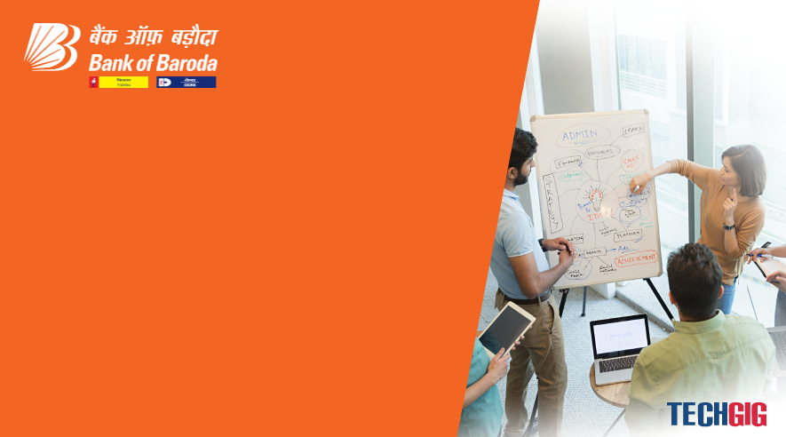

Bank of Baroda Hackathon - 2022
Technology Partner
Your Team Name :
Tragic Bytes
Date : 05/08/2022

Slide 2
Problem Statement
Customer. Vendor. Seller. Buyer.
Every one of them have been around since the idea of business began. Quick forward to 2020. Today, everything without question revolves around the 'Age of the Customer'. Organizations have developed more concerned; some might say, even fixated on how their clients are dealt with. Furthermore, which is all well and good. It just takes one awful experience for the client to stay away from your business for eternity. By a similar rationale, one extraordinary client experience can change over them into faithful brand diplomats, deep rooted.
Clients visit different computerized channels, during this excursion, they might expect help to satisfy the cycle prerequisite, ordinarily clients don't finish the interaction/exchange as they don't have full data. Menial helper might assist with expanding the reception of advanced channels and decrease the expense of activity.

Slide 3
User Segment & Pain Points
All of them have been around since the possibility of business started. Fast forward to 2020. Today, all that without question spins around the 'Age of the Customer'. Associations have grown more concerned;
some could say, even focused on how their clients are managed. Besides, which is fine and dandy. It simply takes one dreadful experience for the client to avoid your business forever.
By a comparable reasoning, one phenomenal client experience can change over them into steadfast brand negotiators, well established.
Clients visit different automated channels, during this trip, they could anticipate that help should fulfill the cycle essential, usually clients don't complete the communication/trade as they don't have full information.
Humble partner could help with extending the gathering of cutting edge channels and lessening the cost of action.

Slide 4
Pre-Requisite
IBM Watson Assistant
See what Virtual Customer Assistants IBM Watson Assistant clients additionally viewed as in their buying choice. While assessing various arrangements, potential purchasers look at abilities in classifications like assessment and contracting, joining and organization, administration and backing, and explicit item capacities.
Look at genuine audits confirmed by Gartner to perceive how IBM Watson Assistant thinks about to its rivals and track down the best programming or administration for your association.

Slide 5
Azure tools or resources
Each organization designer of the clever partner applies his own particular techniques and approaches for improvement, which thus influences the end result. One collaborator can combine discourse all the more subjectively, another can all the more precisely and without extra clarifications and redresses perform errands, others can play out a smaller scope of undertakings, however most precisely and as the client needs. Clearly, there is no widespread colleague who might play out all errands similarly well. The arrangement of attributes that an aide has relies completely upon which region the designer has focused harder on. Since all frameworks depend on AI strategies and use for their creation immense measures of information gathered from different sources and afterward prepared on them, a significant job is played by the wellspring of this information, be it search frameworks, different data sources or interpersonal organizations. How much data from various sources decides the idea of the collaborator, which can result accordingly.
Voice Technology | Brain Technology
Voice Activation | Voice Bio-metrics
Automatic Speech Recognition (ASR) | Dialog Management
(Teach-To-Speech (TTS) | Natural Language Understanding (NLU) Named Entity Recognition NER)

Slide 6
Any Supporting Functional Documents
SOLUTION:
In this advanced time, everyday life became more astute and interlinked with innovation. We definitely know some voice help like google, Siri. and so forth. Presently in our voice help framework, it can go about as a fundamental clinical prescriber, everyday timetable update, note essayist, mini-computer and a pursuit device. This task chips away at voice information and give yield through voice and shows the text on the screen. The principal plan of our voice help makes individuals shrewd and give moment and figured results. The voice help takes the voice input through our receiver (Bluetooth and wired amplifier) and it changes over our voice into PC justifiable language offers the necessary arrangements and responses which are asked by the client. This help interfaces with the internet to give results that the client has addressed. Regular Language Processing calculation helps PC machines to participate in correspondence involving normal human language in many structures.

Slide 7
Plan Work
The work began with examining the sound orders given by the client through the mouthpiece. This can be in any way similar to getting any data, working a PC's inside records, and so forth. This is an exact subjective review, in light of perusing previously mentioned writing and testing their models. Tests are made by programming as per books and online assets, with the express objective to track down prescribed procedures and a further developed comprehension of Voice Assistant.
However, the intricacies don't stop there. Indeed, even with many long periods of information, different variables can assume a tremendous part in whether the product can grasp you. Foundation commotion can without much of a stretch lose a discourse acknowledgment gadget track. This is on the grounds that it doesn't innately can recognize the encompassing sounds it "hears" of a canine yelping or a helicopter soaring over, from your voice. Engineers need to program that capacity into the gadget; they direct information assortment of these surrounding sounds and "tell" the gadget to sift them through. Another element is the manner in which people normally shift the pitch of their voice to oblige for loud conditions; discourse acknowledgment frameworks can be delicate to these pitch changes.

Slide 8
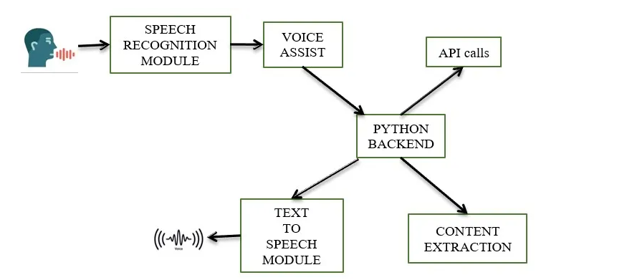
Methodology

Slide 9
Key Differentiators & Adoption Plan
Discourse Recognition module
The framework involves Google's internet based discourse acknowledgment framework for changing over discourse contribution to message. The discourse input Users can acquire messages from the unique corpora coordinated on the PC network server at the data place from the amplifier is briefly put away in the framework which is then shipped off Google cloud for discourse acknowledgment. The same text is then gotten and taken care of to the focal processor.
Python Backend:
The python backend gets the result from the discourse acknowledgment module and afterward distinguishes whether the order or the discourse yield is an API Call and Context Extraction. The result is then sent back to the python backend to give the necessary result to the client.
Programming interface calls
Programming interface represents Application Programming Interface. An API is a product middle person that permits two applications to converse with one another. All in all, an API is a courier that conveys your solicitation to the supplier that you're mentioning it from and afterward conveys the reaction back to you.

Slide 10
Key Differentiators & Adoption Plan
Content Extraction
Setting extraction (CE) is the assignment of naturally removing organized data from unstructured as well as semi-organized machine-meaningful archives. Much of the time, this action concerns handling human language texts utilizing normal language handling (NLP). Ongoing exercises in sight and sound report handling like programmed comment and content extraction out of pictures/sound/video should have been visible as setting extraction TEST RESULTS.
Text-to-discourse module
Text-to-Speech (TTS) alludes to the capacity of PCs to peruse text resoundingly. A TTS Engine switches composed message over completely to a phonemic portrayal, then changes the phonemic portrayal over completely to waveforms that can be yield as sound. TTS motors with various dialects, lingos and particular vocabularies are accessible through outsider distributers.

Slide 11
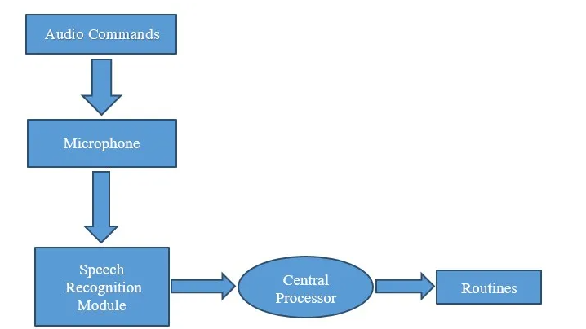
GitHub Repository Link & supporting diagrams, screenshots, if any

Slide 12
Thank You
Team member names: SUJITHA R
SUJITHA N
MANOJ S
VIJAYASRI E

